Slide 1
Progress
Find Extrinsic Parameter
Ellipses Detection
Estimate Rotation & Translation Parameters
Reference:
Chen, Qian, Haiyuan Wu, and Toshikazu Wada. "Camera calibration with two arbitrary coplanar circles." European Conference on Computer Vision. Springer, Berlin, Heidelberg, 2004.

Slide 2
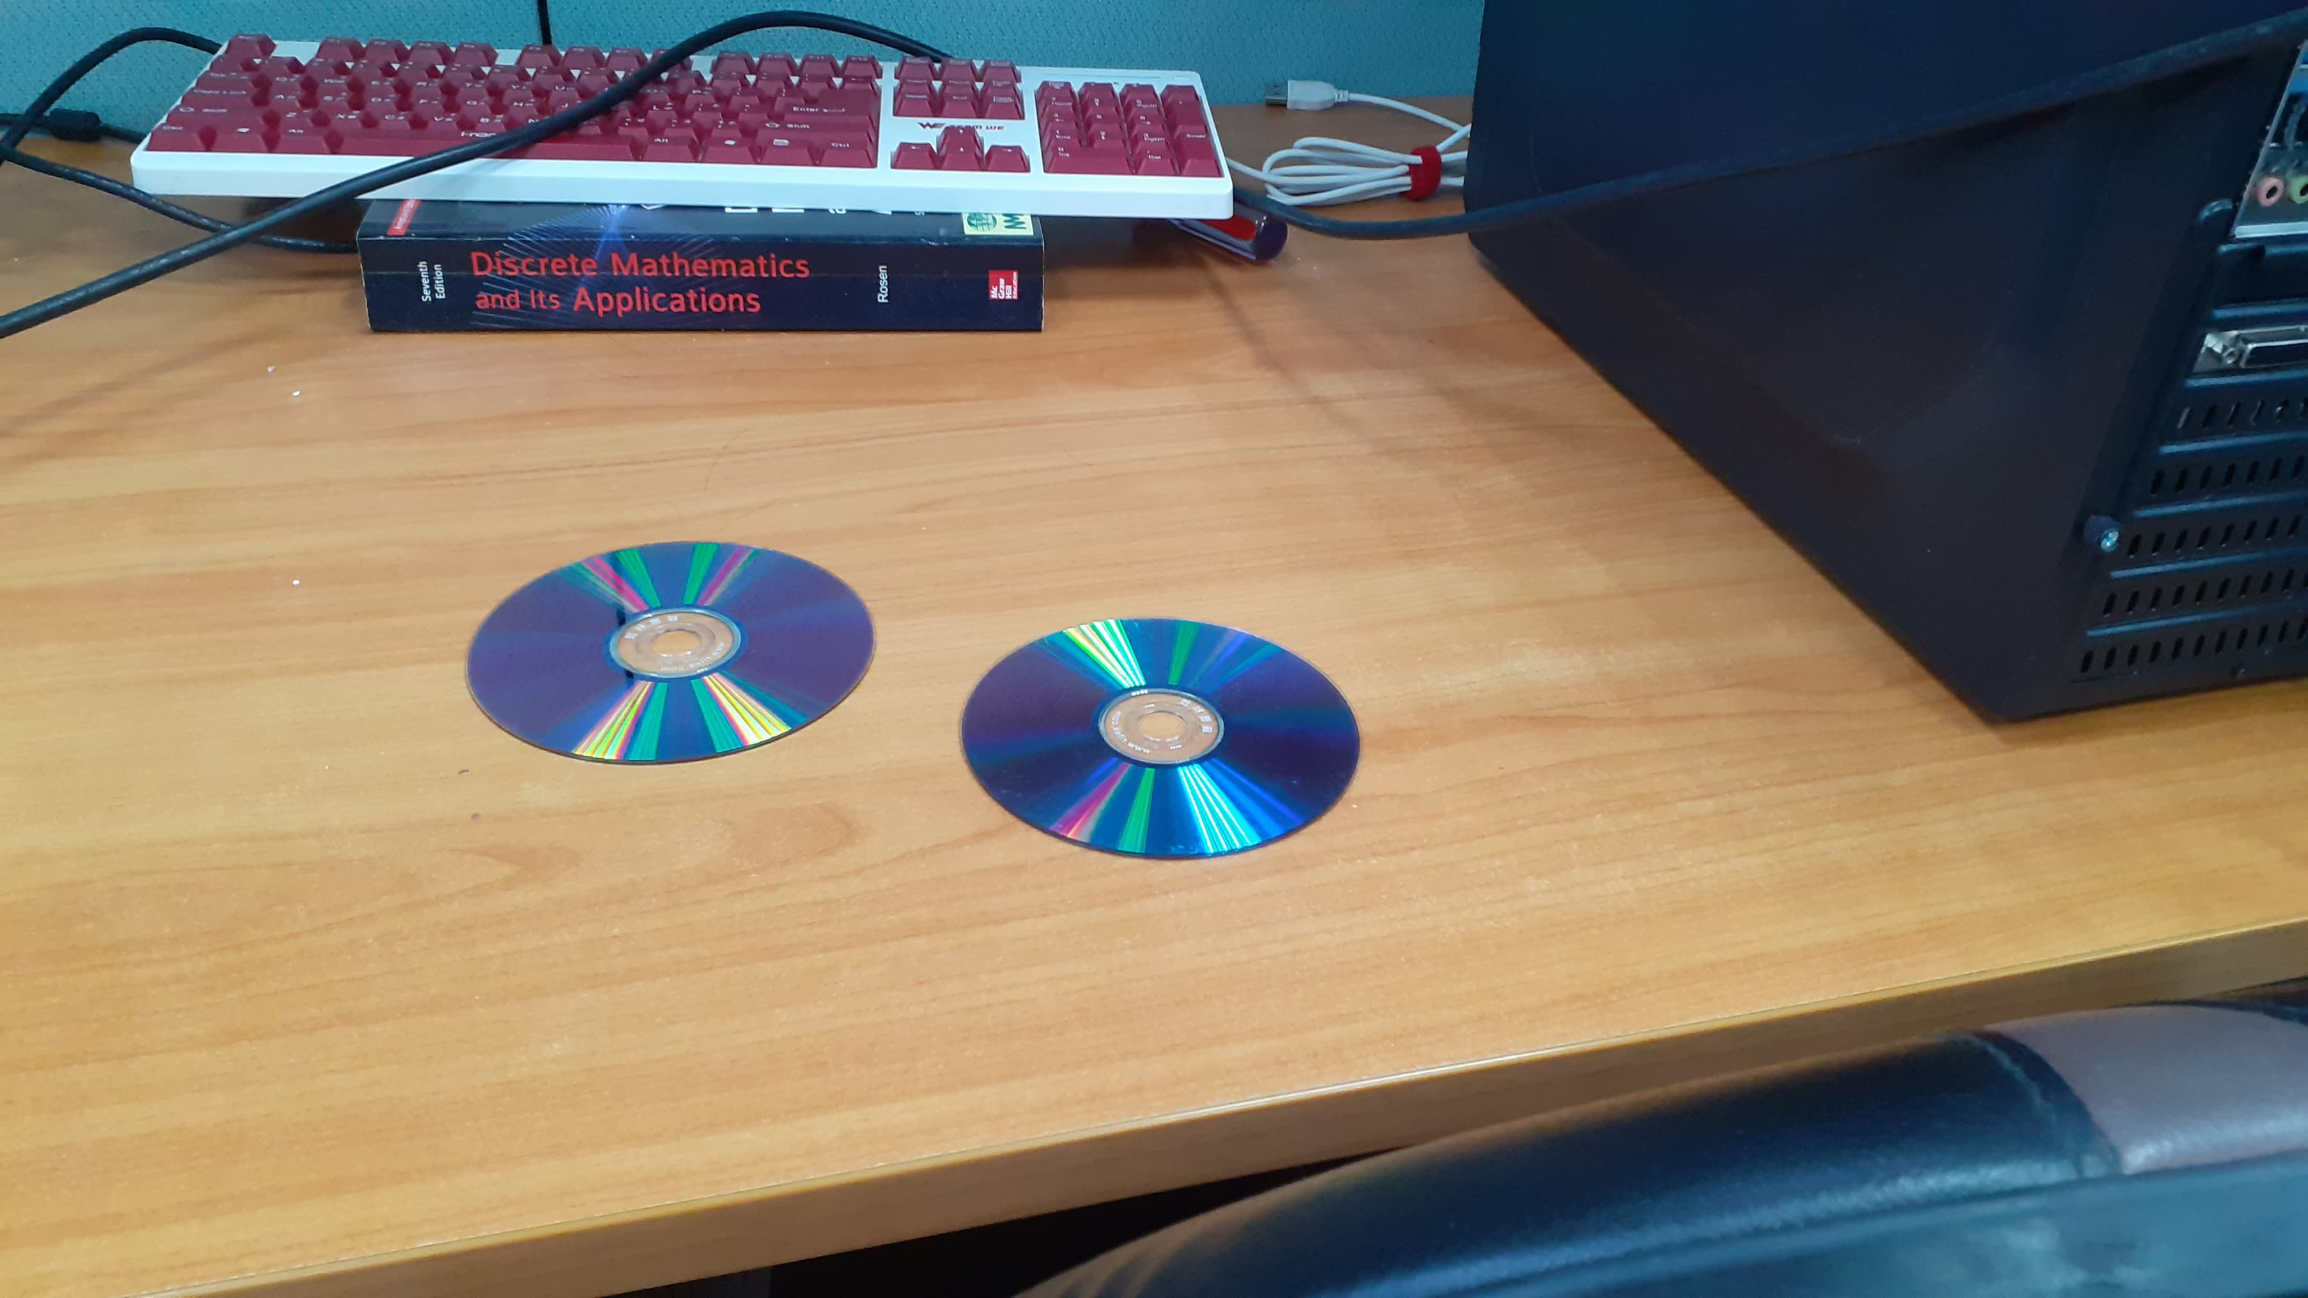
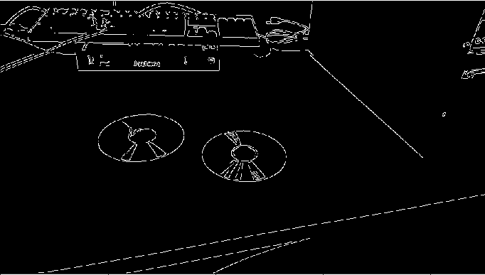
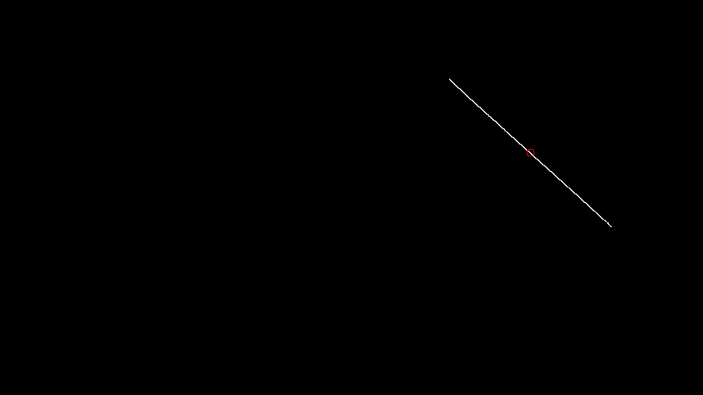
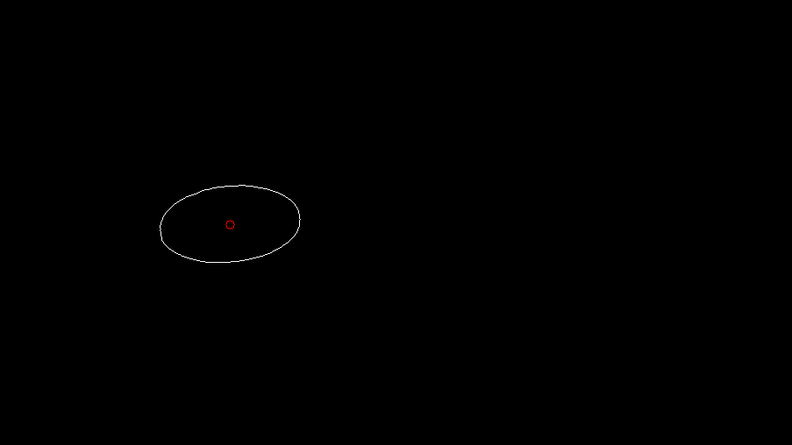
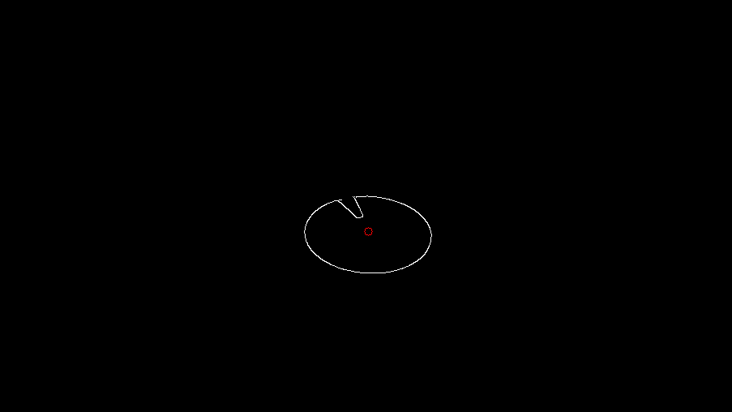
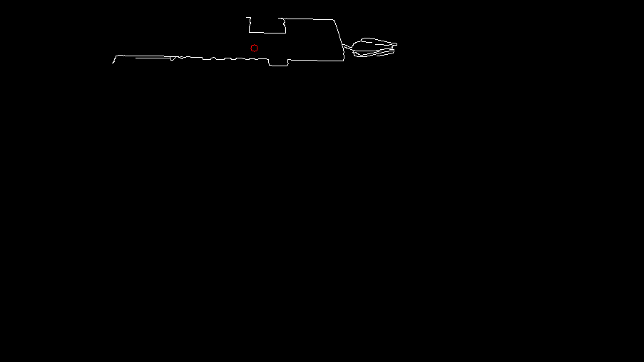
Progress
Ellipses Detection
Canny edge detection
Find Contours
…, etc

Slide 3
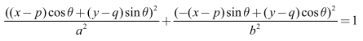
Progress
Ellipses Detection
Ellipses Detection base on Hough Transformation
Reduce 5 parameters ellipse formula to 2 parameters using geometric characteristics
Perform hough transform on all edge point (transform from x-y space to b-θ space, i.e. hough space)
Find the highest vote position in hough space to get the 2 estimated parameters (b & θ)
The max distance from any position in the image to the edge of the ellipse can’t longer than semi-major axes of the ellipse.
Thus, for all positions in the image find the max distance to the edge and choose the position which has shortest max distance as our center (p, q) of ellipse and its max distance as our length of semi-major axes (a).

Slide 4

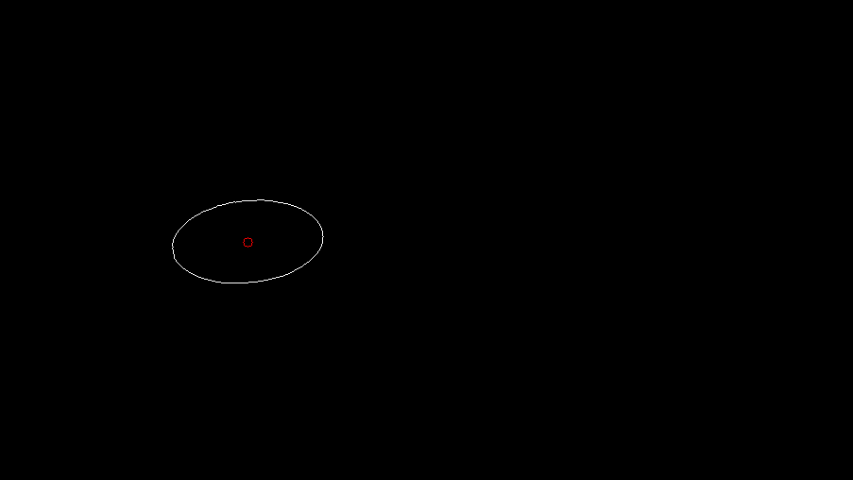

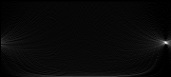


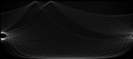
Result
Detected ellipse
Missed (Need a better way to choose correct position)
Input image
Found contours
Max distance of all position
Hough space voting
θ (0~180)
b (0~a-1)
Good voting
Bad voting

Slide 5
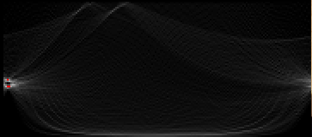
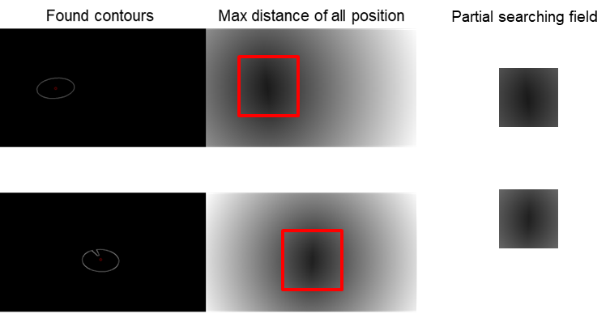
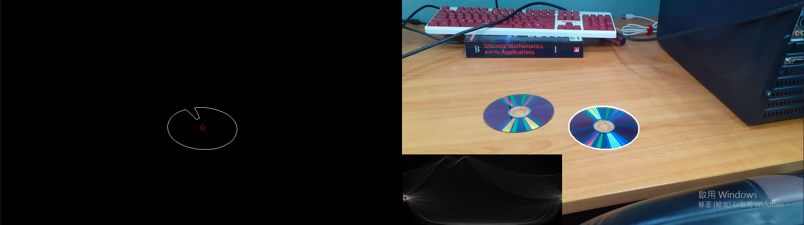
Progress
Improvement of Ellipses Detection
Better way to choose correct voting position
Average of groups of highest points
Speed up performance
Decrease the searching field of center & axes
▲ Decrease the searching field of center & axes
▲ Average of groups of highest points

Slide 6
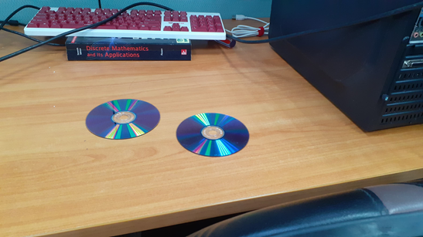
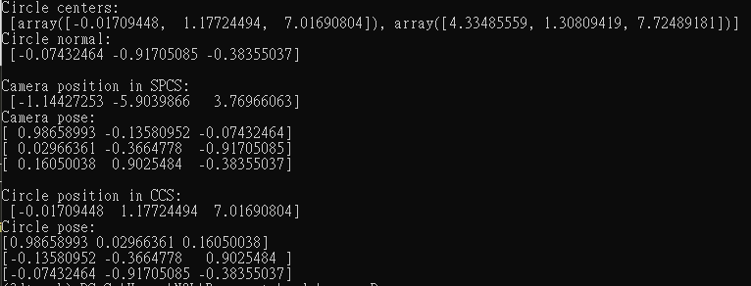
Progress
Estimate Rotation & Translation Parameters
Estimate the camera position & pose in world coordinate system
k
j
O
i

Slide 7

Previous Progress
Find Extrinsic Parameter
Estimate Rotation & Translation Parameters
World Coordinate System (WCS)
Camera Coordinate System (CCS)
Estimate the camera position & pose in world coordinate system (WCS)
Reference:
Chen, Qian, Haiyuan Wu, and Toshikazu Wada. "Camera calibration with two arbitrary coplanar circles." European Conference on Computer Vision. Springer, Berlin, Heidelberg, 2004.

Slide 8
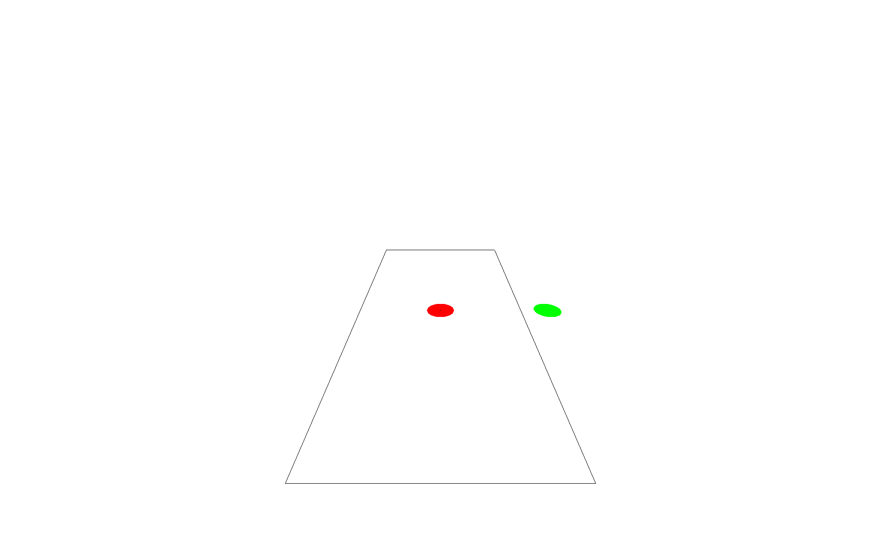
Progress
Evaluate with synthetic image generate by OpenGL
How the following factors affect the accuracy and the success rate of detection of the pattern
Camera distance
Pattern size
Pattern distribution
Viewing pitch
Compare with the chessboard method

Slide 9
Metric
The translation from origin (WCS) to camera position
Error: Mean Square Error (MSE)
The camera pose (3 axis of CCS) present in WCS
Error: Inner Production

Slide 10
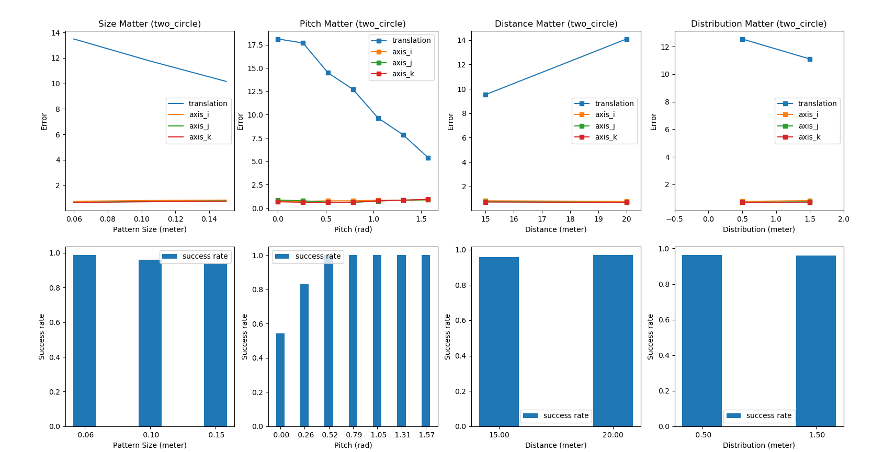
Two circle method

Slide 11
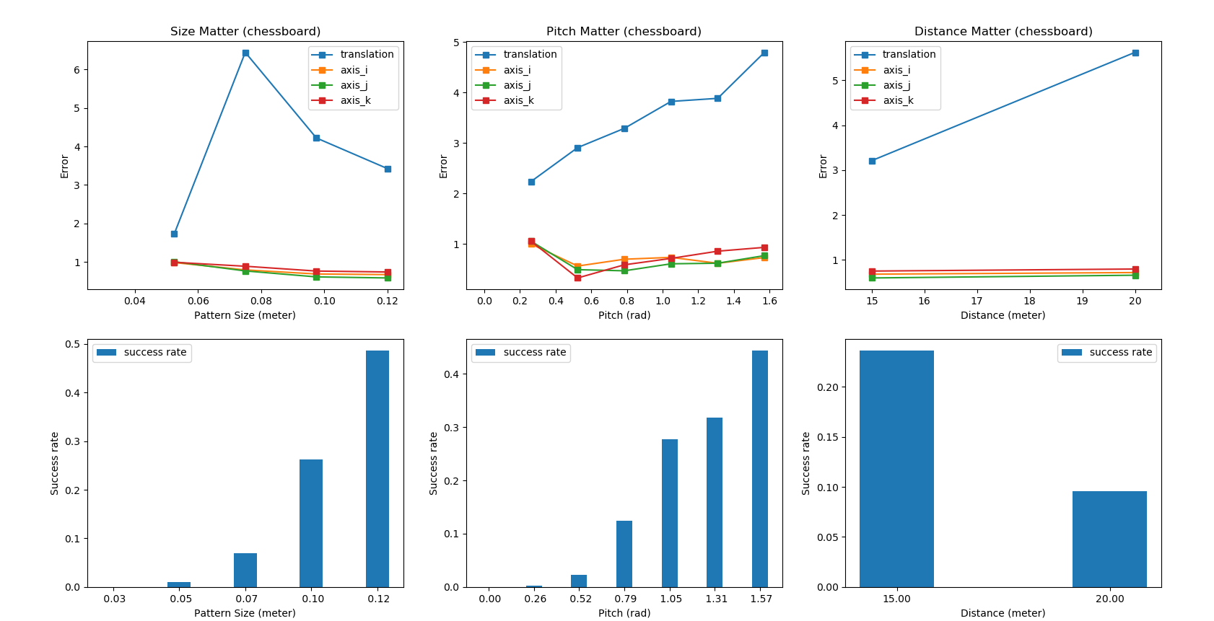
Chessboard method

Slide 12
Conclusion
The translation error is much larger than pose error
Although the overall accuracy of chessboard method is better than two circle method, the success rate that the pattern can be detected is terrible with chessboard method.
With the situation as follow can help improve the performance of two circle method:
Large pattern size
High pitch
Close distance
High distribution

Slide 13
Improve the performance (TODO)
The two circle method still have some bug and some room for improvement:
Fitting more circle to lower the translation error
More realistic filming position and angle
Survey the backup methods
Calibrate by court
Calibrate by vanish point

